Slide 1
Presentation on Angular file Structure
Presented by
k.Venkateswara reddy
Team Panda
Dlihe

Slide 2
Contents :-
Introduction
Installation of Angular
Commands
File Structure
App Folder
Environment Folder

Slide 3
Introduction:-
AngularJS was originally developed in 2009 by Miško Hevery at Brat Tech LLC
Angular is an open-source, JavaScript framework written in TypeScript. Google maintains it, and its primary purpose is to develop single-page applications.

Slide 4
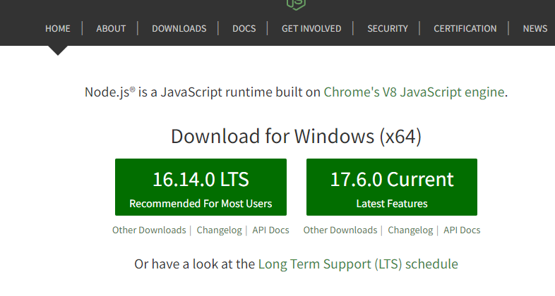
Installation of angular
1. Visit the official Node.js page and download the latest Node.js lateset features

Slide 5
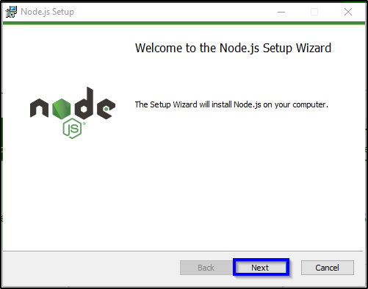

Slide 6
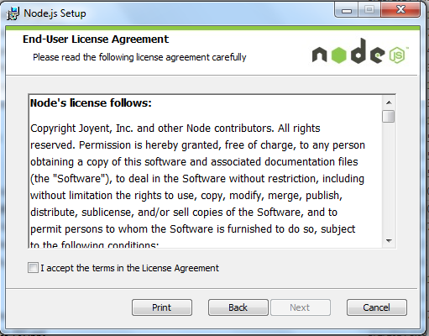
Accept the licence aggrement and click next

Slide 7
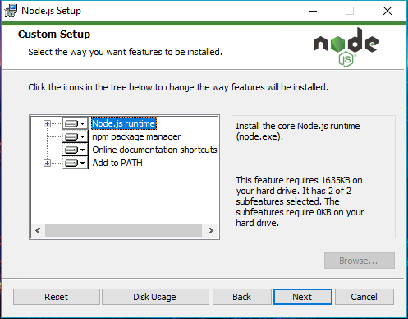

Slide 8
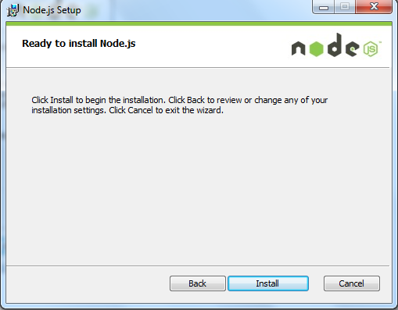
Click on install button to install Node Js

Slide 9
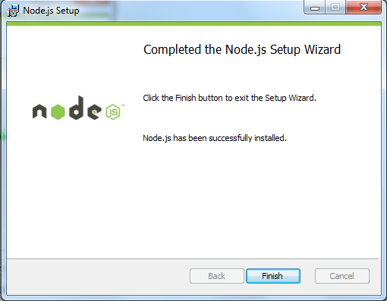
After succesful installation of node js click on finish button.

Slide 10
Commands
npm install -g @angular/cli
ng new my-demo-app
cd my-demo-app
ng serve -o

Slide 11
File structure
node_modules folder –
generated when we run "npm install“. contains third-party libraries and files.

Slide 12
File structure
App folder : -
Contains "modules" and "components" for our Angular application.
Assets folder:-
Here we will keep resources such as images, styles, icons, etc.
Environments folder :-
Help to building the angular application.

Slide 13
App folder :-
app.routing.module.ts –
contains to path of other contains to link the modules.
app.component.css -
Contains the CSS code for the component.
app.component.html -
HTML file pointing to the app component. It is a template for the angular application.

Slide 14
App folder :-
app.component.spec.ts -
Unit testing file associated with app component. It can be generated using "ng test" command.
app.component.ts -
Entire functional logic is written in this file.
app.module.ts –
Type Script file holds all dependencies.

Slide 15
eNvironment folder
It contains the environment configuration constants that help while building the angular application.
It has environment.ts and environment.prod.ts. These configurations are used in angular.json file.

Slide 16
Environment folder
Favicon.io - icon appears in the browser
index.html - Basic HTML file.
main.ts - starting point of our application
polyfills.ts - compile our TypeScript to specific JavaScript methods
styles.css - Global CSS file.
.browserslistrc file –
Browser compatibility and versions are mentioned

Slide 17
Environment folder
.editorconfig - consistency in code editors
angular.json - structure of our application
karma.conf.js - It is used in Unit Testing.
package.json - npm configuration file, we can modify dependency versions
README.md - contains our project description, default
tsconfig.json - TypeScript compiler understands browser

Slide 18
Environment folder
package-lock.json –
Change something on the node_modules or package.json.this file generated.
tsconfig.app.json -
Overrides the tsconfig.json file with relevant app-specific configurations
tsconfig.base.json -
same configuration as compared to tsconfig.json file. introduced in Angular 10+.

Slide 19
Environment folder
tsconfig.spec.json -
overrides the tsconfig.json file, while running the ‘ng test’ command
tslint.json –
It is a static analysis tool. For tracking of readability, maintainability, and functionality errors.

Slide 20


